Slide 1
Schedule
First Quarter
Second Quarter
Why Study Church History?
Origin of the Lord’s Church
Post-Apostolic Apostasy
Post-Apostolic Persecution
Edict of Milan & Aftermath
Fall of Rome
Rise of Islam
The Holy Roman Empire
Catholicism vs. The Bible
Protestant Reformation
Presbyterian Church
Church of England
Baptist Church
Methodist Church
Holiness Movement
Mormonism
Jehovah’s Witnesses
Restoration

Slide 2
Notes:
Most catholic doctrine has its roots in pagan idolatry. As the church enjoyed peace during the post-nicene period, it began to compromise with pagans that flooded the church to maintain peace. As a result, doctrines found nowhere in scripture were developed into a religious system falsely identified with Christianity. Many of these doctrines were not invented until centuries after the beginning of the NT church.
In this study, we’ll examine common catholic doctrines and what the bible does and does not say about them. As with all false religions, we want to be sensitive towards those caught up in Catholicism while also standing for what is true and right. Our loyalty must always be to Jesus Christ and His word and any religion or doctrine that does not have the Lord’s authority must be renounced.

Slide 3
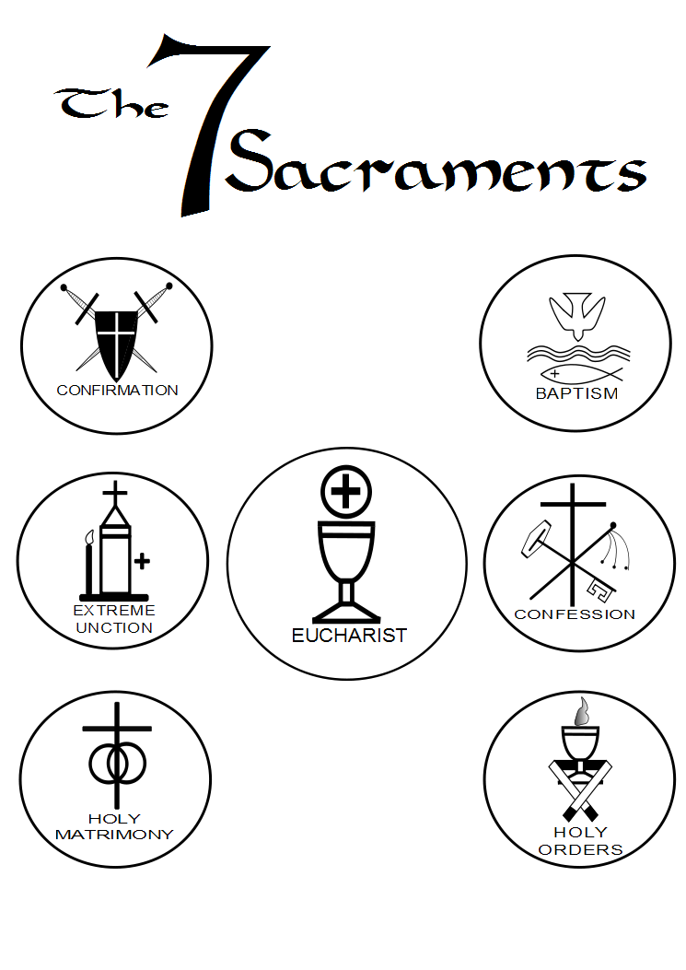
Sacraments
Catholic Teaching
“A sacrament is an outward sign instituted by Christ to give grace…The sacrament gives the grace, which it signifies, by some inherent power attached to the outward sign by Christ Himself, or as theologians say, ex operato, that is, by performing the work which Christ as instituted.” (Question Box, p. 747)
Subjugates the laity to the clergy
Notes:
The term “sacrament” is derived from the Latin word “sacramentum” which means “a thing set apart as holy.” However, the NT never isolates certain acts of obedience from others by designating them as “sacraments.” As the early church (late first century and onward) began to drift from the New Testament pattern of teaching, certain acts began to be distinguished from others as conveying a special sort of “grace.” Some of these practices originally had a biblically-based background but were then perverted by misguided and/or unscrupulous teachers.
By medieval times (from about A.D. 500 to 1500), the Roman Church (deeply steeped in considerable error by this time) had isolated what its “clergy” called the “sacraments.” It was not until the 16th century that they were cataloged as seven. These were: Baptism, Confirmation, Penance, the Eucharist, Sacred Orders, Holy Matrimony, and Extreme Unction.
The Augustinian cleric, Hugo of St. Victor (1096-1141) characterized the “sacraments” as “outward and visible signs of an inward and spiritual grace.” Some Protestants, while rejecting five of the so-called “sacraments,” nonetheless adorned both “baptism” and the “Lord’s supper” with the “sacramental” mantle. This paved the way for the false notion that these rites, in and of themselves, bestowed “grace” – this very different from a faith-motivated, personal submission to the will of God (as in the case of infant baptism).
Always hungry for more power, one of the purposes of introducing this teaching is to exalt the hierarchy above the laity since it is the exclusive prerogative of the clergy to officiate these sacraments, placing the whole matter of salvation in the hands of the hierarchy and relegating the people to a subjugated role to the church.

Slide 4
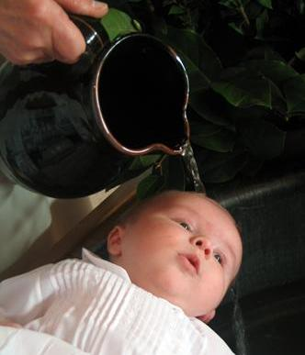
Sacraments (Baptism)
Catholic Teaching
“The teaching of the church is simply this: Baptism is necessary for children as well as adults, in order that they may be saved. Every child born into this world has the guilt of original sin upon its soul…Original sin excludes from heaven unless forgiven. It is forgiven only by baptism. Hence when an unbaptized child dies it cannot enter the kingdom of heaven…The soul of the child will not go to heaven, it is true; but neither will it go to a place of torment; it will go to what is called the “limbo of infants.”” (Question Box, pp. 1,5)
“Catholic teaching is that baptism both by pouring and by immersion is valid…In former times baptism by immersion was very common in the Holy Church; but in the course of centuries baptism by pouring has become the common practice because it obviates numerous inconveniences.” (Question Box, p. 4)
Notes:
Baptism is Catholic sacrament that actually has roots in scripture. They even believe that baptism washes away sins, contrary to the belief of most worldwide denominations. However, they err in two important fundamental facets:
First, Catholics believe that infants must be baptized as a result of what they believe is “inherited” or “original” sin. Because they believe all children are born having inherited sin from their parents, they believe the only thing that can save them is if they are baptized. Interestingly, the Catholic church later changed their view that infants not baptized who die go to hell because of public outcry. And so they invented what they call a “limbo of infants” where all unbaptized infants who die go instead of hell.
Second, Catholics admit that while baptism was solely by immersion in the early church, because of its “inconveniences”, pouring is now allowed. This has now become the primary practice of the Catholic church.

Slide 5
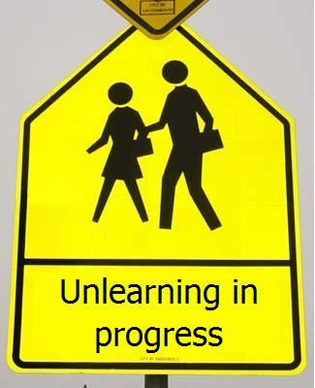
Sacraments (Baptism)
Bible Teaching
Ezek 18:20 – “The person who sins will die. The son will not bear the punishment for the father’s iniquity, nor will the father bear the punishment for the son’s iniquity; the righteousness of the righteous will be upon himself, and the wickedness of the wicked will be upon himself.”
Matt 19:14 – “But Jesus said, “Let the children alone, and do not hinder them from coming to Me; for the kingdom of heaven belongs to such as these.”
Eccl 7:29 – “Behold, I have found only this, that God made men upright, but they have sought out many devices.”
Notes:
Regarding the doctrine of “original sin”, the bible teaches otherwise.
In Ezek 18, the people were complaining that they were captivity not because of their sin but because of their parents sins. God makes it very clear that the son will not bear the punishment for the father’s iniquity nor will the father inherit the sin from his sons iniquity. Every person is responsible for their personal sin. If we have inherited sin all the way back from Adam, why does God make this claim?
In Matt 19:4, Jesus was receiving children and making the point that the kingdom belonged to such as them. If children are born in sin and subject to condemnation, why are they compared to those who will go to heaven? Jesus recognizes the innocent quality of children and encourages us all to mimic those qualities.
In Eccl 7:29, Solomon assures us that when God makes men, He makes them upright. We become separated from Him when we seek out “devices”. In other words, sin is not something that is inherited, it is something that is done/committed. It is an action resulting from the free will of every individual.

Slide 6
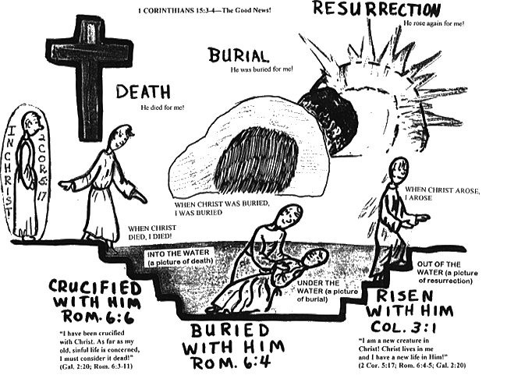
Sacraments (Baptism)
Bible Teaching
Acts 8:36-37a – “As they went along the road they came to some water; and the eunuch said, ‘Look! Water! What prevents me from being baptized?’ And Philip said, ‘If you believe with all your heart, you may.’”
Mark 16:16 – “He who has believed and has been baptized shall be saved; but he who has disbelieved shall be condemned.”
Rom 6:4 – “Therefore we have been buried with Him through baptism into death, so that as Christ was raised from the dead through the glory of the Father, so we too might walk in newness of life.”
Notes:
Regarding the Catholic church’s position on “pouring” instead of immersion, this violates several principles in scripture regarding baptism.
First, Phillip tells the Ethiopian Eunuch in Acts 8 that belief is a requirement for someone who wants to be baptized. If infants do not have the capacity to believe, they are not qualified to be baptized.
Second, Jesus Himself makes belief a requirement for salvation in Mark 16. So important is belief that Jesus does not even mention baptism in the second clause – the reason for this is that baptism means nothing if the person does not have faith.
Third, Paul tells us in Rom 6:4 that baptism is a burial into the death of Christ. If you cannot bury a man by pouring dirt on his head, neither can a person being baptized in water be baptized in any way other than pure immersion. Too, the meaning of the word baptism is “immersion” and therefore should be practiced as such inconvenient or not.

Slide 7
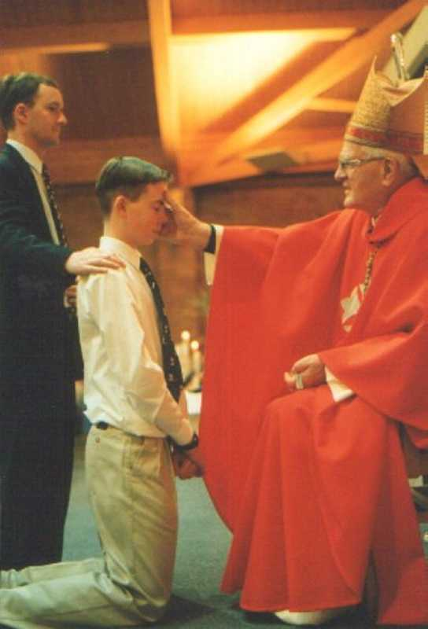
Sacraments (Confirmation)
Catholic Teaching
“It is not easy to decide when this Sacrament was instituted by or Lord, as Holy Writ does not clearly state it.” (Question Box, p. 712)
“Confirmation perfects baptismal grace; it is the sacrament which gives the Holy Spirit in order to root us more deeply in the divine filiation, incorporate us more firmly into Christ, strengthen our bond with the Church.” (#1316, p. 367)
“A sacrament of the New Law in which a baptized person receives the Holy Ghost, is strengthened in grace and signed and sealed as a soldier of Jesus Christ. The minister in the Latin rite anoints with Chrism and imposes hands, saying, ‘I sign thee with the sign of the cross and confirm thee with the Chrism of salvation, in the name of the Father, and of the Son, and of the Holy Ghost.’” (Catholic Dictionary, p. 122)
Notes:
Even Catholics admit that their sacrament of confirmation has no basis at all in scripture. If it cannot be found in scripture, it should not be included in the works that equip a Christian (2 Tim 3:16-17). The point of Catholic confirmation is to bind people to the Catholic religion and to keep them bound by its manmade traditions.
“More firmly”? We’re either in Christ or we’re not in Christ. To suggest a person can become more firmly a Christian is also not a concept taught in scripture. At some point, we have to decide whether we are going to follow God-inspired scripture or the words of man.

Slide 8
Sacraments (Confirmation)
Bible Teaching
2 Cor 5:17 – “Therefore if anyone is in Christ, he is a new creature; the old things passed away; behold, new things have come.”
Rom 8:1 – “Therefore there is now no condemnation for those who are in Christ Jesus.”
Matt 15:9 – “But in vain do they worship me, teaching as doctrines the precepts of men.”
Notes:
2 Cor 5:17 teaches that if a person is in Christ, he is a new creature. There is no middle ground. If the Catholic church teaches a person who is baptized is saved but they also need a second confirming, they are going beyond the bounds of truth as revealed in scripture.
Rom 8:1 assures us that there is no condemnation for those who are in Christ Jesus. If that is true, why does there need to be a confirmation? What exactly is a person confirming if the Catholic church already claims he/she is saved?
Matt 15:19 warns against those who would invent doctrines. Like many Catholic doctrines, confirmation is a teaching the Catholic church invented that is foreign to God’s word and gives them control over the laity.

Slide 9
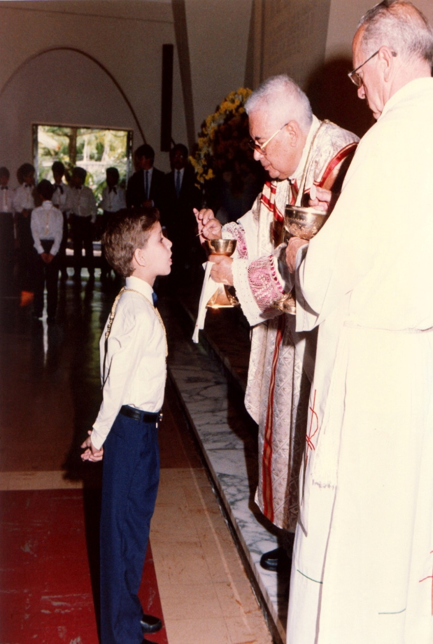
Sacraments (Eucharist)
Catholic Teaching
“A sacrament of the New Law in which, under the appearances of bread and wine, the Body and Blood of Christ are truly, really and substantially present, as the grace-proclaiming food of our souls. Moreover, ‘it is very true that as much is contained under either species as under both; for Christ, whole and entire, exists under the species of bread, and under each particle of that species; and whole under species of wine, and under it’s separate parts’” (Question Box p. 186)
Beginning in 1415 (Counsel of Constance) the cup was withheld from the “laity”
Notes:
Catholicism teaches that in the Lord’s Supper, which they refer to as the Eucharist, the elements, when consumed turn into the literal body and literal blood of the Jesus Christ – they call this “transubstantiation”. They believe that within the elements, Christ is really, truly, and substantially present which means they believe that he is sacrificed again and again, each time the communion is taken.
One example of Catholic flip-flopping takes place between 1200 AD– 1970AD when Catholic laity were forbidden to drink the fruit of the vine as it was considered revered for clergy only. This was not the case before 1200AD. In other words, for the first thousand years of the church, laity could drink of the cup. Then the Pope decided against it beginning in 1200AD. Then in 1970, under the reforms of Vatican II, laity were again allowed the cup. This is one of many ever shifting and changing doctrinal evolutions that has been present in the Catholic church for hundreds of years.

Slide 10
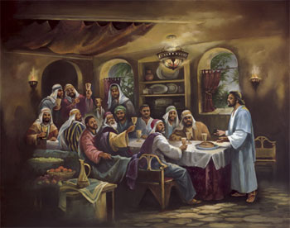
Sacraments (Eucharist)
Bible Teaching
Matt 26:26-29 – “²⁶While they were eating, Jesus took some bread, and after a blessing, He broke it and gave it to the disciples, and said, ‘Take, eat; this is My body.’ ²⁷And when He had taken a cup and given thanks, He gave it to them, saying, ‘Drink from it, all of you; ²⁸for this is My blood of the covenant, which is poured out for many for forgiveness of sins. ²⁹But I say to you, I will not drink of this fruit of the vine from now on until that day when I drink it new with you in My Father’s kingdom.’”
1 Cor 11:23-24 – “²³For I received from the Lord that which I also delivered to you, that the Lord Jesus in the night in which He was betrayed took bread; ²⁴and when He had given thanks, He broke it and said, ‘This is My body, which is for you; do this in remembrance of Me.’”
Notes:
Matt 26:26-29 - First, Jesus had not yet been crucified when the L.S. was instituted. Therefore how could it be His body and His blood? Second, Jesus said “all of you”. Third, after referring to it as His blood and praying, He then referred to it in vs 29 as the fruit of the vine. Fourth, calling it His body and blood is figurative language. Was Jesus a literal door, shepherd, and vine?
1 Cor 11:23-24 – These Christians were eating bread and drinking the cup (v.26) in memory of Jesus’ body and blood (vv. 24-25). The false doctrine of transubstantiation destroys the memorial and sign.

Slide 11
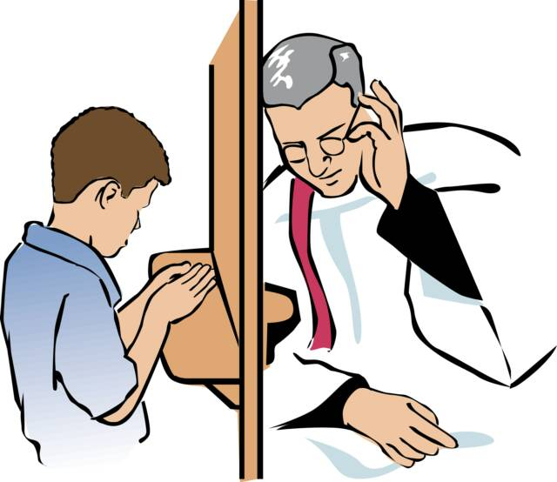
Sacraments (Penance)
Catholic Teaching
“After hearing a penitent’s confession and before giving him absolution, a confessor (priest) must impose a penance. While such a penance rarely nowadays bears any real relation to the gravity of the sins confessed, it must be in some sense proportionate thereto.” (Catholic Dictionary, p. 397)
Notes:
Catholicism believes that a priest has the power to forgive or retain sins and impose penance as a means of testing the genuineness of the person's confession and of making a satisfaction to God for that sin. Penance is performing outward acts such as repeating prayers like the "Hail Mary" or the “Rosary” as a payment for sin and to satisfy God. Roman Catholicism bases penance on Ezekiel 18:30, Luke 13:5 and Acts 2:38 where they incorrectly translate "repentance" (metanoeo = to turn, repent, to change one's mind) as “penance”. Eventually, penance evolved into indulgences which was a heinous practice that stirred men of the Reformation movement.

Slide 12
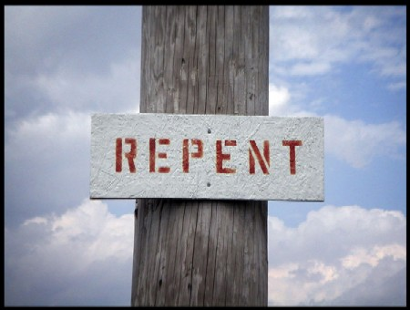
Sacraments (Penance)
Bible Teaching
Repentance (change of mind about sin) is commanded in the NT but penance is unheard of.
1 John 1:9 – “If we confess our sins, He is faithful and just to forgive us our sins, and to cleanse us from all unrighteousness.”
Luke 13:5 – “… but unless you repent, you will all likewise perish.”
Acts 17:30 – “Therefore having overlooked the times of ignorance, God is now declaring to men that all people everywhere should repent.”
Notes:
1 John 1:9 - We only confess our sins to God. No mention is made of penance here or anywhere. No good works that we do by penance will ever satisfy God, but sinners can be accepted and forgiven only on the ground of Christ's sacrifice, through which alone the justice and wrath of God against sin have been satisfied. (Romans 3:24-28)
Luke 13:5, Acts 17:30 – These are the words of Jesus. Simply, “repent”. No mention of penance.

Slide 13
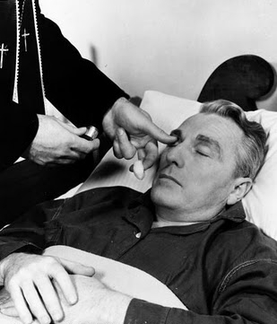
Sacraments (Extreme Unction)
Catholic Teaching
“A sacrament of the New Law in which, by anointing with oil and the prayers of the priest, health and soul and (sometimes) of body is conferred on a baptized person who is in danger of death through sickness.” (Catholic Dictionary, p. 194)
Notes:
Catholicism teaches a sacrament called Extreme Unction that they reserve for those who are very sick or close to death. It is an ordinance by which they anoint the forehead with oil, usually in the sign of the cross, and thereby prepare them to meet God if they should die.
As with many Catholic doctrines, this ordinance finds its source not in the bible, but in pagan rituals. This practice originated in Babylon as an anointing for the last journey into the mysteries. It goes as far back as the god of Babylon called Nimrod which means, “Lord of Oil”. It transferred through the years to the Roman god Saturn whose statue was filled with oil and was used by pagans to prepare idol worshippers to meet their god in a vision or to prepare them for their death. Catholics picked up this heathen practice at the end of the 6th century and introduced it as a sacrament to prepare those dying to meet their God.

Slide 14
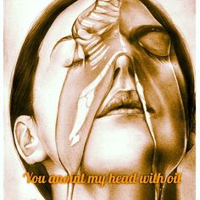
Sacraments (Extreme Unction)
Bible Teaching
Jas 5:14-15 – “¹⁴Is anyone among you sick? Then he must call for the elders of the church and they are to pray over him, anointing him with oil in the name of the Lord; ¹⁵and the prayer offered in faith will restore the one who is sick, and the Lord will raise him up, and if he has committed sins, they will be forgiven him.”
The elders of Jas 5 were married men, not unmarried priests in the Roman Catholic Church (Tit 1:5-6)
1st century church had a plurality of elders who were called
Elders may have had the power to perform healing because of the laying on of hands of the Apostles
Notes:
Catholics attempt to justify the practice of Extreme Unction by referring to Jas 5:14-15. However, this verse and Catholic Extreme Unction differ considerably.
First, the elders of Jas 5 were married men (1 Tim 3; Tit 1:5-6) not unmarried catholic priests.
Second, the 1st century church had a plurality of elders that would have been called or the one who was sick, not just one man.
Third, its very possible the elders in the first century would have had the power to perform healing because of the laying on the hands of the apostles. With the passing of spiritual gifts, it is possible this practice may have died with it. However, I would be careful to assume this since this particular evidence is speculative.

Slide 15
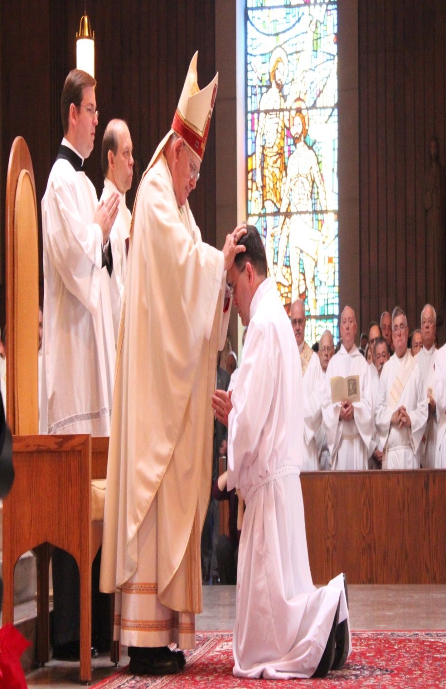
Sacraments (Holy Orders)
Catholic Teaching
“A sacrament by which bishops, priests, and other ministers of the Church are ordained and receive the power and grace to perform their duties. In addition to the effects of sanctifying grace, this Sacrament likewise imprints an indelible character upon the soul. Hence, one who is validly ordained priest cannot be deprived of his priesthood, even though he can be suspended from the exercise thereof; nor can he by his own free will, by heresy or apostasy, for example, lose the character imprinted on his soul” (The Question Box, pp. 469, 470).
Laymen’s terms: a “layman” is changed into a “clergyman” and has the power to bless anyone, anything, rule the flock, administer the “sacraments” and forgive sins (power even the Lord’s apostles never possessed)
Notes:
Holy Orders is the Catholic sacrament that justifies a separation of clergy and laity in the minds of Catholics. Catholicism teaches that men of the clergy are endowed by God with special powers. Their claim is that this special power is imprinted permanently upon the soul of the clergyman in question and that it provides the power to forgive sins. In essence, clergymen are made mediators between God and man in the minds of Catholics.

Slide 16
Sacraments (Holy Orders)
Bible Teaching
1 Tim 2:5 – “For there is one God, and one mediator also between God and men, the man Christ Jesus”
1 Pet 2:9 – “But you are a chosen race, a royal priesthood, a holy nation, a people for God’s own possession, so that you may proclaim the excellencies of Him who has called you out of darkness into His marvelous light.”
Notes:
1 Tim 2:5 teaches that only Christ is the mediator between God and man and no one else. In truth, to be a Christian is the highest calling a person can have in the kingdom of God. To teach there is a higher calling than that is a doctrine of man and not of God as it goes against scripture.
1 Pet 2:9 teaches that all Christians are a royal priesthood and a holy nation. To claim there is a priesthood that is separated from the general Christian population is to go against the very man inspired by the Holy Spirit that Catholics claims was their first pope.

Slide 17
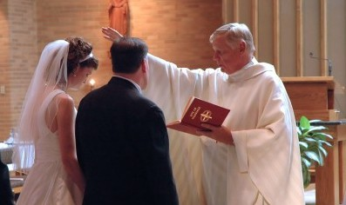
Sacraments (Matrimony)
Catholic Teaching
“The Sacrament of Matrimony is a contract between a man and a woman both of whom are baptized and free to enter into the contract, to live together for the purpose of begetting and rearing children and of cherishing one another in a common life.”
“The marriages of the unbaptized are not sacramental” (Catholic Dictionary, p. 333).
Notes:
Holy Matrimony refers to the institution of marriage. The Roman Catholic Church contends that marriage is a “church” institution, and since they believe that the Catholic church is the true, universal church of Christ, the Roman Church claims marital jurisdiction over all who have been “baptized” in that communion. Therefore, while to them marriage between Catholics is considered a “sacrament” (Council of Trent, Sess. xxix, can. 2), marriage between two non-Catholics is but a mere “contract.” Contrary to the teaching of Jesus Christ (Mt. 5:32; 19:9), the Catholic Church permits no valid cause for divorce.
However, with influence in the right places, and especially if one has sufficient financial resources, an “annulment” (i.e., a declaration that one’s original marriage never was valid) can be effected on almost any basis, and Catholics may remarry following the annulment. Modern clergymen are as adept as were the ancient Pharisees at manipulating divine law for a desired result
Some time ago, Bill O’Reilly, of Fox news fame, himself a Roman Catholic, made the ludicrous claim that the Roman Catholic Church “invented” marriage. That is what might be dubbed, “spin” theology

Slide 18
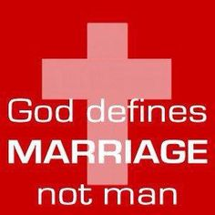
Sacraments (Matrimony)
Bible Teaching
Matt 19:4-6 – “⁴And He answered and said, “Have you not read that He who created them from the beginning made them male and female, ⁵and said, ‘For this reason a man shall leave his father and mother and be joined to his wife, and the two shall become one flesh’? ⁶So they are no longer two, but one flesh. What therefore God has joined together, let no man separate.””
Notes:
Marriage was not a catholic invention, but originates from Creation itself when God ordained it for all mankind. Jesus affirms this fact in Matt 19:4-6. Christians do agree that marriage makes man and woman better and can help them to become closer to Christ, but not in the sacramental since Catholicism teaches.

Slide 19
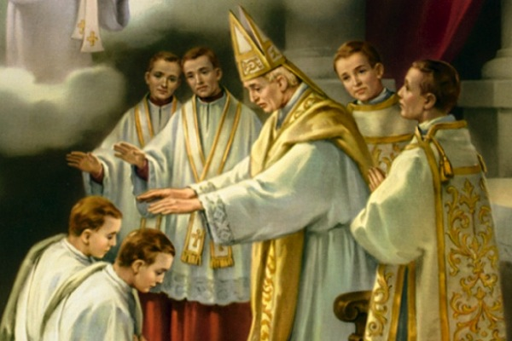
Celibacy
Origin
Clergy/laity distinction caused emperors to want take it a step further
Practiced in 4th century during the rise of monasticism
First enforced in 1079 by Gregory VII, over 1000 years after the NT church was established
Notes:
The fact that celibacy was not even introduced as a Catholic doctrine until 1079AD, over 1000 years after the church began, should raise concerns among all honest thinking people. The Catholic church admired the ascetic lifestyle of the monastic movement. That along with a desire to further make a distinction between clergy and laity most likely led the Catholic church to make this distinction.

Slide 20
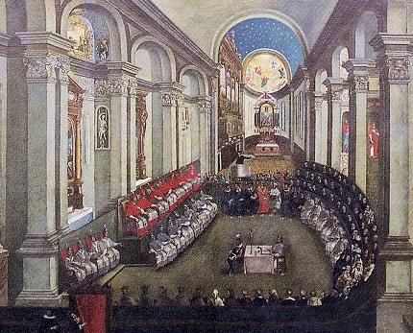
Celibacy
Catholic Teaching
“If anyone saith that the marriage state is to be preferred before the state of virginity, or celibacy, and that it is not better and more blessed to remain in virginity, or in celibacy, than to be united in matrimony, let him be anathema.” (Tenth Canon, Council of Trent)
“Whoever shall say that the clergy constituted in sacred order, or regulars, who have solemnly professed chastity, may contract marriages and that the contract is valid, let him be accursed.” (Tenth Canon, Council of Trent)
“Conjugal chastity….throughout the centuries have redeemed woman from the slavery of a duty submitted to through force and humiliation.” (Pope Paul addressing the 13th Congress of the Italian Women’s Center in 1966)
Notes:
Not only do Catholics demand celibacy for its clergy, they pronounce condemnation upon anyone who says otherwise. In fact, they condemn anyone who claims that marriage is a better arrangement than celibacy in general. To add icing to the cake, Catholics have accused the marriage arrangement as being one in which women are forced into slavery and humiliation. These statements run in opposition to their belief that marriage is a sacrament that bestows grace upon its participants. The Catholic cannot have its cake and eat it too.

Slide 21
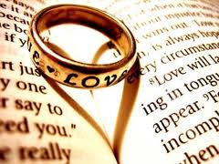
Celibacy
Bible Teaching
Gen 2:18 – “Then the Lord God said, ‘It is not good for the man to be alone; I will make him a helper suitable for him.’”
1 Tim 4:1-3 – “But the Spirit explicitly says that in later times some will fall away from the faith, paying attention to deceitful spirits and doctrines of demons…men who forbid marriage...”
Matt 8:14 – “When Jesus came into Peter’s home, He saw his mother-in-law lying sick in bed with a fever.”
1 Cor 9:5 – “Do we not have a right to take along a believing wife, even as the rest of the apostles and the brothers of the Lord and Cephas?”
1 Tim 3:2 – “An overseer, then, must be above reproach, the husband of one wife, temperate, prudent, respectable, hospitable, able to teach…”
1 Cor 7:2 – “But because of immoralities, each man is to have his own wife, and each woman is to have her own husband.”
Notes:
Since the beginning, God has created marriage to be for man’s good (Gen 2:18). Jesus confirmed this in Matt 19:4-6 though hundreds of years had passed. We must ask the question whether we are going to trust God and His arrangement, or trust the Catholic church who have managed to invent doctrines counter to God’s word.
Paul prophesied that movements would arise that forbade marriage in 1 Tim 4:1-3. This is a shocking revelation that shows the Holy Spirit was testifying with Him. It also shows that asceticism was on the rise even during the apostolic age (Col 2:21)…that Paul could see it coming.
If Peter was truly the first pope, why was He married? We learn he was married during Jesus’ day (Matt 8:14) and that he was still married 25 years later. If celibacy for the clergy is law, Peter didn’t know it and 25 years after the resurrection of Christ, he still didn’t know it.
If clergy are to be celibate, why are two of the requirements for bishops that he be the husband of one wife with believing children? Did this requirement expire? What gives the Catholic church the right to render such a law null and void?
1 Cor 7:2 lets us know that part of marriage’s design is to keep immoralities in check. With so many Catholic priests caught in sexual scandals involving children, it begs the question who we should put our confidence in: God’s word or Catholic tradition?

Slide 22
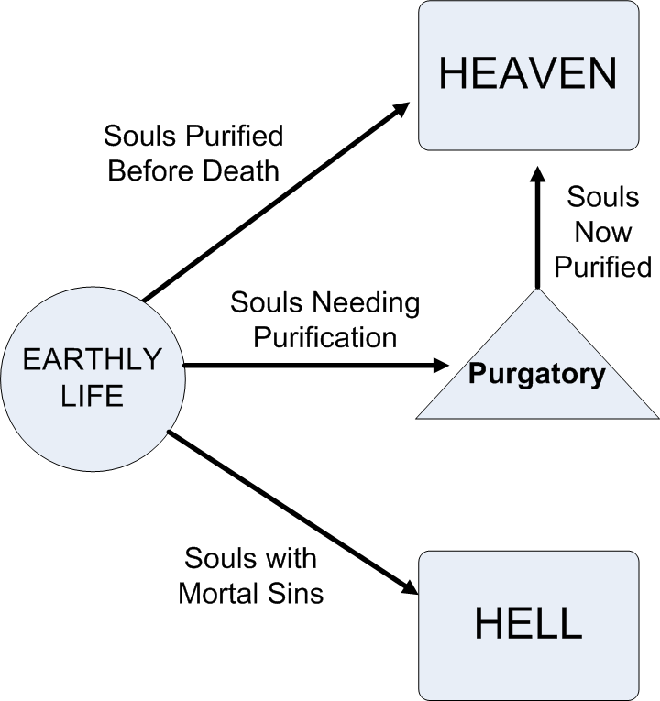
Purgatory
Origin
First taught in 606AD
How Began?
Molech (Lev 18:21) - infant sacrifice by burning
Tammuz (Ezek 8:14) - “Tam” means “perfect”; “Muz” means “by burning”
Taught by Buddhism, Stoicism, and Muslim fathers
Result:
Discourages holiness, encourages sin
Notes:
Purgatory was not officially accepted by the Catholic church until 606AD, but its origin in paganism dates back a lot further. Since Catholicism really began to take off after the days of Constantine when pagans flooded the church and brought their superstitions, its no wonder a doctrine such as this (which is foreign to the bible) would rear its ugly head.
Molech, the detestable God of the Philistines and Ammonites, was a god in which idol worshippers sacrificed children by fire because it was believed Molech would guarantee financial prosperity for the parents as well as their children. Later, another god evolved from this one called “Tammuz”. Jews were known to sacrifice to this god in the temple itself during the time prior to the destruction of Jerusalem by the Babylonians (Ezek 8:14). Children were sacrificed to this god because it was believed it would perfect them by burning. “Tam” means “perfect” and “Muz” means burning. Therefore, Tammuz itself means “perfected by burning”.
Others throughout history taught this – Plato, Virgil, and other Stoic philosophers. It was also taught by Buddhism and early Muslim fathers. However it is never taught by the bible. It is a doctrine wholly invented by man that actually encourages sin by claiming there is a place that you go to suffer before heaven as long as you don’t commit “mortal sins”.

Slide 23
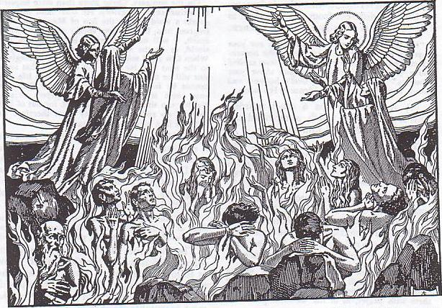
Purgatory
Catholic Teaching
“The place and state in which souls suffer for a while and are purged (thus the name “purgatory”) after death, before they go to heaven, on account of their sins” (Catholic Dictionary, p. 437).
“The truth has been divinely revealed that sins are followed by punishments. God's holiness and justice inflict them. Sins must be expiated. This may be done on this earth through the sorrows, miseries and trials of this life and, above all, through death. Otherwise the expiation must be made in the next life through fire and torments or purifying punishments.” (Second Vatican Council, p. 63)
Encouraged Catholic Doctrines
Indulgences (remission of temporal punishment due to those sins of which the guilt has been forgiven). Money used to build cathedrals
Encouraged people to join Crusades
Contributed to extermination of heretics
Notes:
Catholics claim this is a divinely revealed truth, but they must claim to be the source of that “truth” since this teaching is found nowhere in scripture. The worst part of this doctrine is the other false doctrines that it led too:
Indulgences were offered to Catholic laity in the middle ages to avoid time in purgatory. Indulgences was one of the most hotly contested catholic doctrines during reformation times and purgatory has a direct connection to it. Too, the money gotten from the selling of indulgences was used to build massive Catholic cathedrals, many of which still exists today in Europe and ensured a permanent face for the Catholic church while they stand.
The doctrine of purgatory also encouraged people to join the Crusades. The popes at that time offered anyone who joined the Crusades a free pass from purgatory. Men lined up ready to give their life in physical combat with Muslims if it meant a one-way ticket to heaven.
When “heretics” arose to combat the false doctrines of the Catholic church, the Pope promised a free pass out of purgatory for any Catholic who turned them in.

Slide 24
Purgatory
Bible Teaching
1 John 1:7 – “But if we walk in the Light as He Himself is in the Light, we have fellowship with one another, and the blood of Jesus His Son cleanses us from all sin.”
Heb 9:27-28 – “And inasmuch as it is appointed for men to die once and after this comes judgment, so Christ also, having been offered once to bear the sins of many, will appear a second time for salvation without reference to sin, to those who eagerly await Him.”
Heb 10:14 – “For by one offering He has perfected for all time those who are sanctified.”
Notes:
To say that our sins are expiated by our suffering is an insult to the cross of Christ since it says that the cross was not sufficient to cleanse us of our sins.
1 John 1:7 assures us that the blood of Christ cleanses us from all sin. Heb 9:27-28 claims that when Jesus returns, it will be without reference to sin. Catholics, however, claim that more sin on behalf of those cleansed by the blood of Christ must be atoned for in purgatory. Heb 10:14 further assures us that Christ’s sacrifice perfects for all time those who have been sanctified.

Slide 25
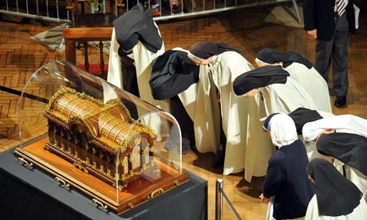
Veneration of Relics
Origin
Rooted in Roman paganism
Rome filled the Olympus with gods and demigods of their heroes (Nimrod)
Arises from a natural instinct of man to admire champions of their race even after they have died
This may explain why God buried Moses Himself (Deut 34:5-6; Jude 9)
Notes:
The veneration of relics also traces back to paganism due to a desire on behalf of man to admire their champions once they pass on. Both Rome and Greece filled their cities with god and demigods of even those passed on heroes. When paganism invaded the early church, it was natural for them to bring in this temptation to the church. Therefore, Christian martyrs were admired to the point that their relics, bones, etc. were collected and kept as keepsakes. They were thought to bring grace/power to the one who acquired them.
Though speculative, it makes you wonder why God Himself buried Moses. As much as Israel struggled with idolatry, if they could have dug up Moses then they probably would have (Deut 34:5-6; Jude 9).

Slide 26
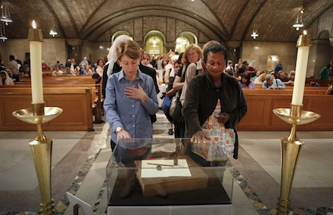
Veneration of Relics
Catholic Teaching
“The corpse of a saint or any part thereof; any part of his clothing; anything intimately connected with him. The veneration of relics can be traced at least to the middle of the 2nd century and was regulated by the Council of Trent, which directed that no new relics should be admitted without episcopal authentication” (Ibid., p. 448)
It is said that Rome has the comb of the rooster that crowed for Peter, bones of the apostles, wood from the cross, etc.
Notes:
Catholics claim any object connected with the fallen martyr is intimately connected with him and that it bestows special favor and power when acquired. As a result, many pilgrimages were undertaken to acquire such objects in the early days – tombs were ransacked and desecrated. Rome actually claims to have the comb of the rooster that crowed after Peter’s denial, bones of the apostles, wood from the cross, etc.

Slide 27
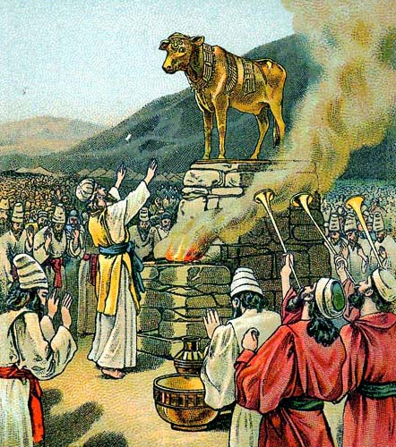
Images
Origin
Began in 405 AD
Image worship finds its root in all forms of idolatry going as far back as the early days of the OT (Ex 32)
In Rome & Greece, idols were everywhere and pagans would not separate themselves from it even when they became “Christians”
Notes:
Of all catholic traditions that are found outside the bible, the worship of images is the easiest to trace to paganism. This was being practiced by the Israelites during their early history (Ex 32). Pagans could not separate themselves from this culture when they became nominal Christians and therefore they began to admire images of Christ, Mary, and other saints.
Despite the fact that this is forbidden in even the 10 commandments, Catholics persist in image worship. In fact, the Catholic catechism, when listing the 10 Commandments, deliberately leaves out the 2nd commandment. Coincidence?

Slide 28
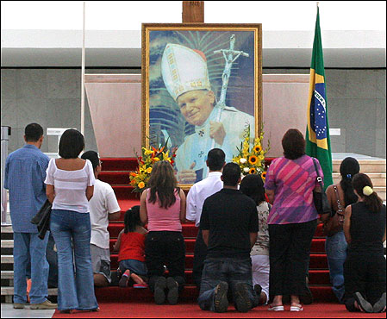
Images
Catholic Teaching
“The images especially of Christ, of the Virgin Mother of God, and of other saints, are to be had and kept in churches and due honor and reverence paid to them; not because it is believed that there is any divinity or power in them…but because the honor shown to them is referred to the prototypes which they represent; so that through these Images which we kiss and before which we bow with bared heads, we worship Christ and honor the saints whose likeness they display” (Council of Trent).
Joe Malone, in “Why I Left the Catholic Church” (p. 219) states: “Life Magazine, reporting the ceremonies in Ottawa, Canada, in June, 1947, at the Marion Congress, pointed out that a great procession of devout people knelt and kissed the foot of the giant statue of Mary ‘until the paint wore off its toes.’”
Notes:
Its important to note that these images aren’t to just aid the worshipper in the Catholic mind, they are to actually be worshipped. They are to be kissed and bowed to. Joe Malone, an ex-Catholic, claims that one statue of Mary was kissed so much that the paint was eventually worn off of the feet.

Slide 29
Images
Bible Teaching
Ex 20:4-5a – “⁴You shall not make for yourself an idol, or any likeness of what is in heaven above or on the earth beneath or in the water under the earth. ⁵You shall not worship them or serve them;”
Acts 17:29-30 – “²⁹Being then the children of God, we ought not to think that the Divine Nature is like gold or silver or stone, an image formed by the art and thought of man. ³⁰Therefore having overlooked the times of ignorance, God is now declaring to men that all people everywhere should repent.”
Rom 1:22-23 – “²²Professing to be wise, they became fools, ²³and exchanged the glory of the incorruptible God for an image in the form of corruptible man and of birds and four-footed animals and crawling creatures.”
Notes:
The ten commandments are ancient and sound. For the Catholic to not only ignore the 2nd commandment but to also delete it from their catechism shows that they know their image worshipping is in direct conflict with the bible. Again, Catholics must be challenged whether to except what these men say or what God’s word says.
Paul, while in Athens, explicitly states to the idolaters there that God should not be looked at as an image because He is not a created being and therefore stands out far above all created beings. He is not to be limited to a creation of any kind.
In Rom 1:2-23, Paul calls this type of worship foolish. Catholics, however, say it is required.

Slide 30
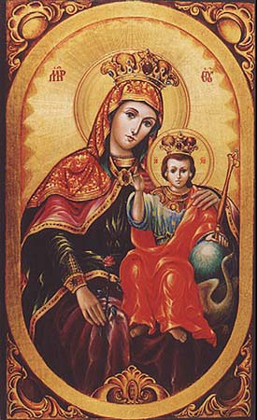
Mariolatry
Evolution
431AD – Mary is called the Mother of God
451AD – Mary declared a perpetual virgin
600AD – prayers offered to Mary declared final by the Council of Trent
1854AD – the immaculate conception of Mary "finalized" by Pope Pius IX
1965AD – was when Mary was declared the “mother” of the church

Slide 31
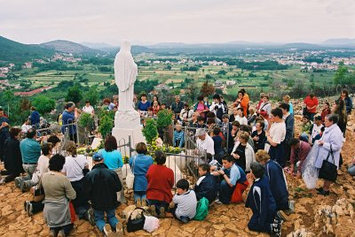
Mariolatry
Origin
Pagan practice stemming from the worship of the queen of heaven
Jer 7:18 – “The children gather wood, and the fathers kindle the fire, and the women knead dough to make cakes for the queen of heaven; and they pour out drink offerings to other gods in order to spite Me.”
Jer 44:17 – “But rather we will certainly carry out every word that has proceeded from our mouths, by burning sacrifices to the queen of heaven and pouring out drink offerings to her, just as we ourselves, our forefathers, our kings and our princes did in the cities of Judah and in the streets of Jerusalem; for then we had plenty of food and were well off and saw no misfortune.”

Slide 32
Mariolatry
Bible Teaching
Matt 1:24-25 – “And Joseph awoke from his sleep and did as the angel of the Lord commanded him, and took Mary as his wife, but kept her a virgin until she gave birth to a Son; and he called His name Jesus.”
Matt 13:55-56 – “Is not this the carpenter’s son? Is not His mother called Mary, and His brothers, James and Joseph and Simon and Judas? And His sisters, are they not all with us? Where then did this man get all these things?”
Luke 11:27-28 – “While Jesus was saying these things, one of the women in the crowd raised her voice and said to Him, ‘Blessed is the womb that bore You and the breasts at which You nursed.’ But He said, ‘On the contrary, blessed are those who hear the word of God and observe it.’
1 Cor 9:5 – “Do we not have a right to take along a believing wife, even as the rest of the apostles and the brothers of the Lord and Cephas?”

Slide 33
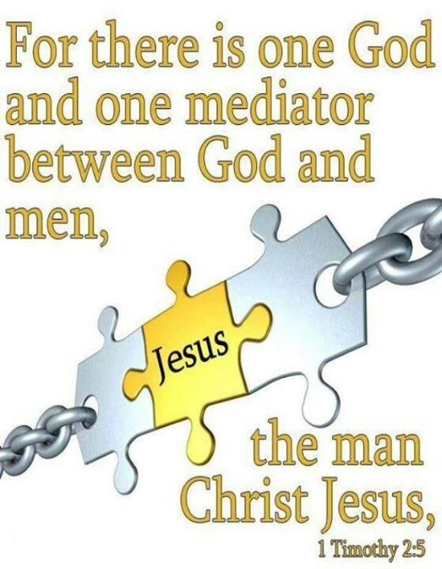
Mariolatry
Bible Teaching
1 Tim 2:5 – “For there is one God, and one mediator also between God and men, the man Christ Jesus.”
John 14:14 – “If you ask Me anything in My name, I will do it.”
Acts 4:11-12 – “¹¹He is the stone which was rejected by you, the builders, but which became the chief corner stone. ¹²And there is salvation in no one else; for there is no other name under heaven that has been given among men by which we must be saved.”

